Slide 1

www.sadhvisoft.com
INTERNSHIP PROJECT
REPORT
TITLE :Amazon sales Analysis
NAME :Rishad A
BATCH :01
©2023 Sadhvisoft Copyright

Slide 2

Table of Contents
01
02
03
04
About Project
Details of Data
Tools Used
Main KPI’s
05
06
07
Screenshots
My Design
Conclusion
www.sadhvisoft.com

Slide 3
ABOUT PROJECT
Analyzing Amazon sales data is crucial for understanding customer preferences and optimizing product offerings. However, extracting meaningful insights from the dataset, including product details, user reviews, and pricing information, poses a challenge. The problem at hand is to develop a systematic approach for extracting valuable information from this dataset, enabling businesses to enhance decision-making, identify popular products, and improve overall customer satisfaction. The goal is to derive actionable insights that can inform marketing strategies, pricing decisions, and product improvements based on user feedback.
www.sadhvisoft.com

Slide 4
DETAILS OF DATA
Rating data. The primary dataset used for this analysis is the 'Amazon sales analysis.csv’ file containing the detailed information about each review and rating made by the customer
EDA will be performing in amazon sales data analysis and it a interesting dataset to work on . Explore the popularity of products based on the number of user reviews and ratings
data loading and inspection
handling the missing values
data cleaning and formatting
www.sadhvisoft.com

Slide 5
TOOLS USED
Pandas
Matplotlib
Seaborn
Power bi
www.sadhvisoft.com

Slide 6
MAIN KPI”s
Tasks
Identifying top 5 products based on rating
Analyze the distribution of product prices, including both discounted and actual prices.
Identify and list products that have the highest number of user reviews
Explore the popularity of products based on the number of user reviews and ratings.
Identifying most discussed product based on the number of user reviews and ratings.
www.sadhvisoft.com

Slide 7
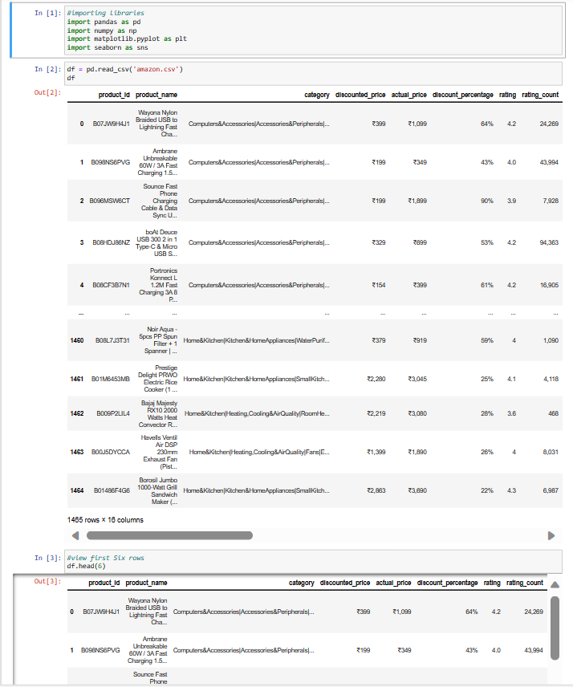
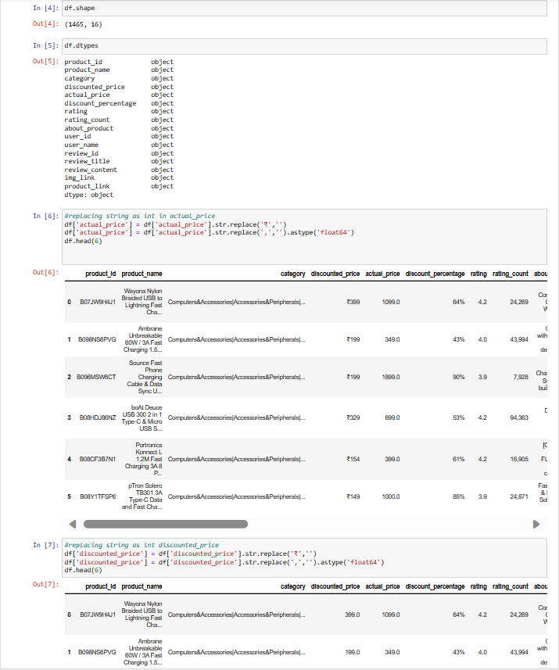
SCREENSHOTS
Python Code
www.sadhvisoft.com

Slide 8
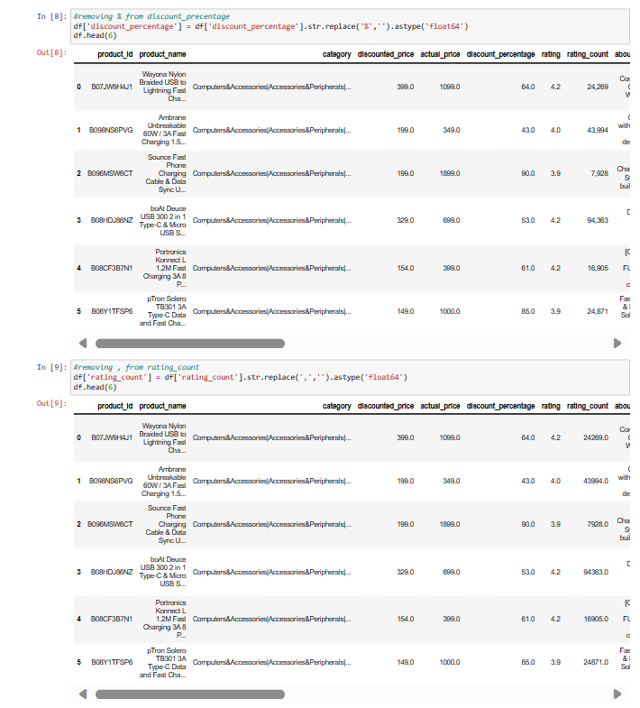
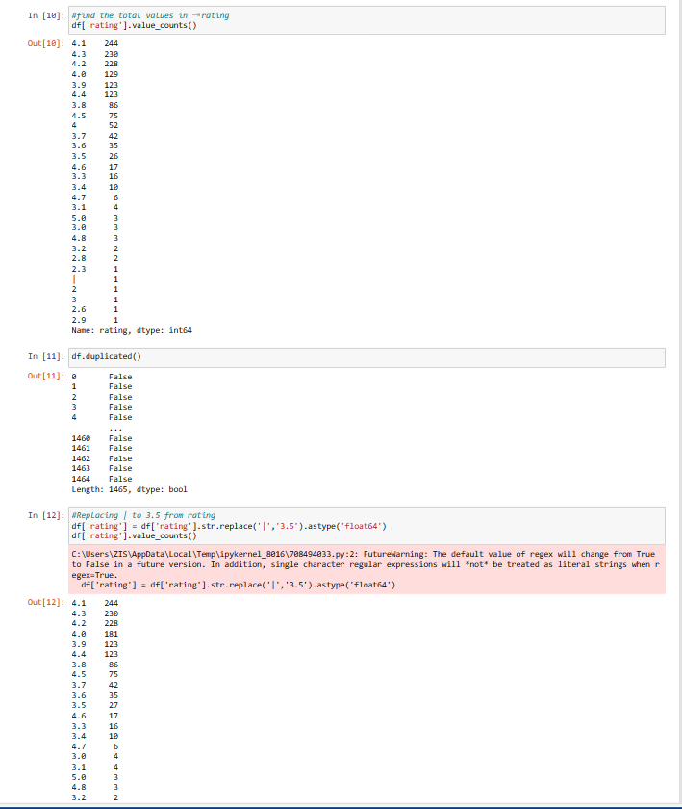
SCREENSHOTS
Python Code
www.sadhvisoft.com

Slide 9
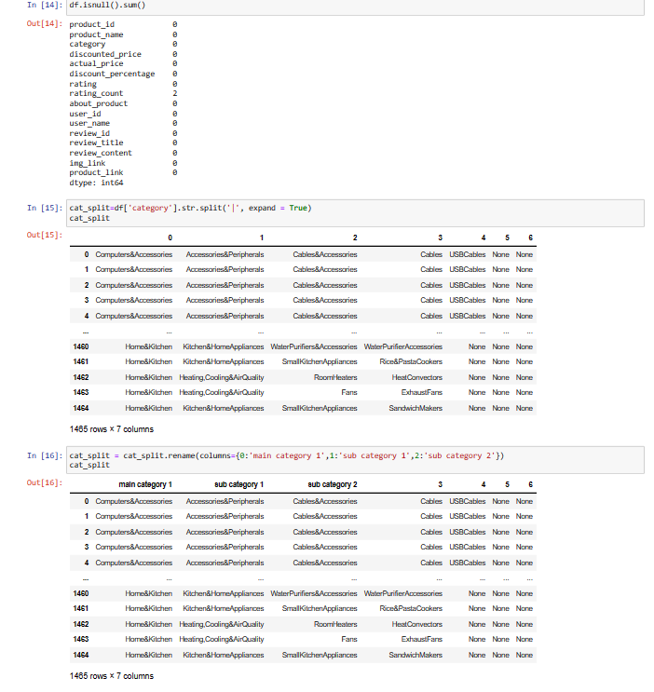
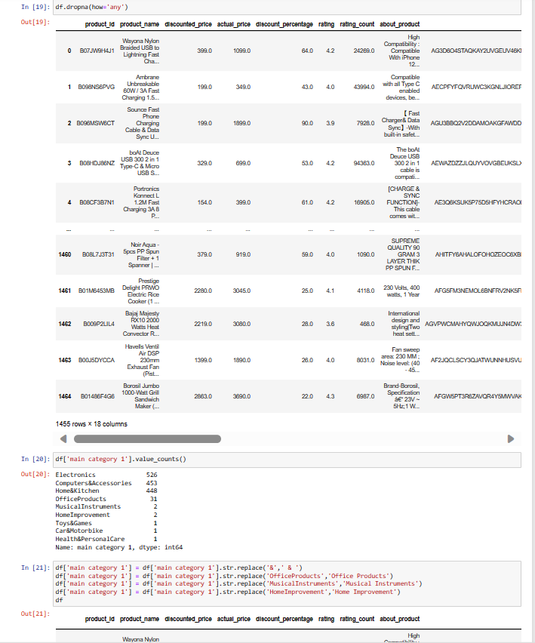
SCREENSHOTS
Python Code
www.sadhvisoft.com

Slide 10
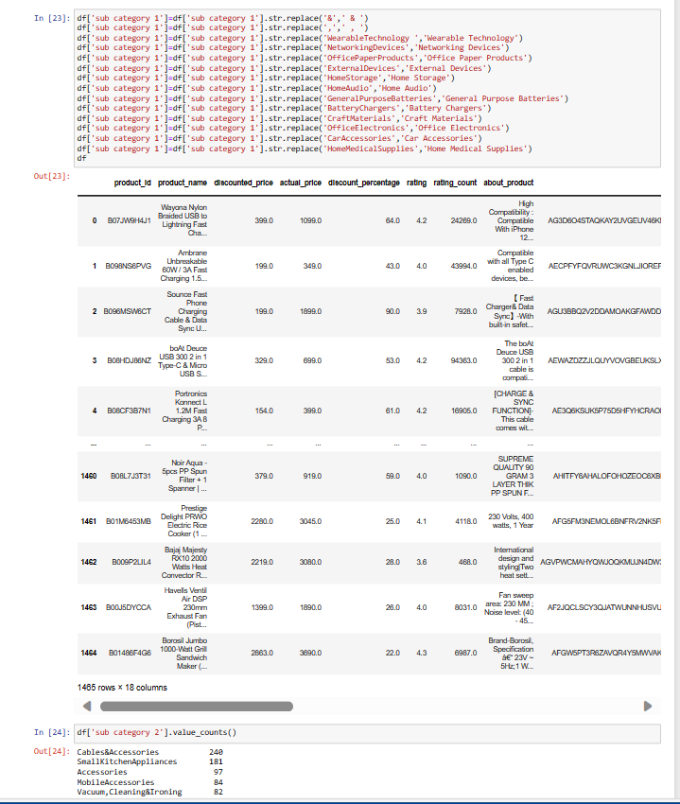
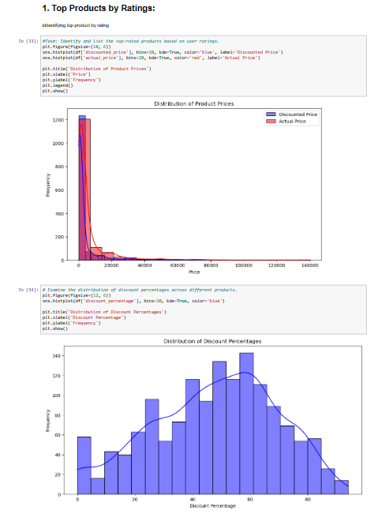
Python Code
www.sadhvisoft.com

Slide 11
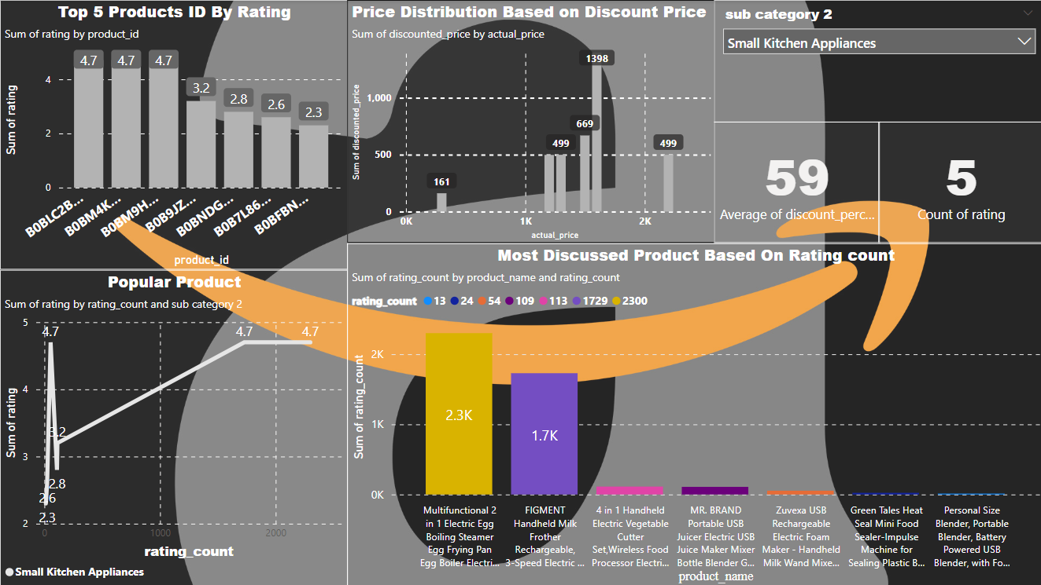
MY DESIGN
Powerbi
www.sadhvisoft.com

Slide 12
CONCLUSION
Based on the analysis we recommend the following action:
1)Invest in marketing and promotion during the sale at peak
2)Focus on expanding and promoting the product
3)implementing a coustomers segmentaion stratergy to target most reviewed customers
www.sadhvisoft.com

Slide 13
www.sadhvisoft.com
Thank You!
©2023 Sadhvisoft Copyright
www.sadhvisoft.com

